Slide 1
How to fill out an FOI form...
Prepared by: Colin Craig, Canadian Taxpayers Federation
For: Creative Communications Program, Red River College

Slide 2
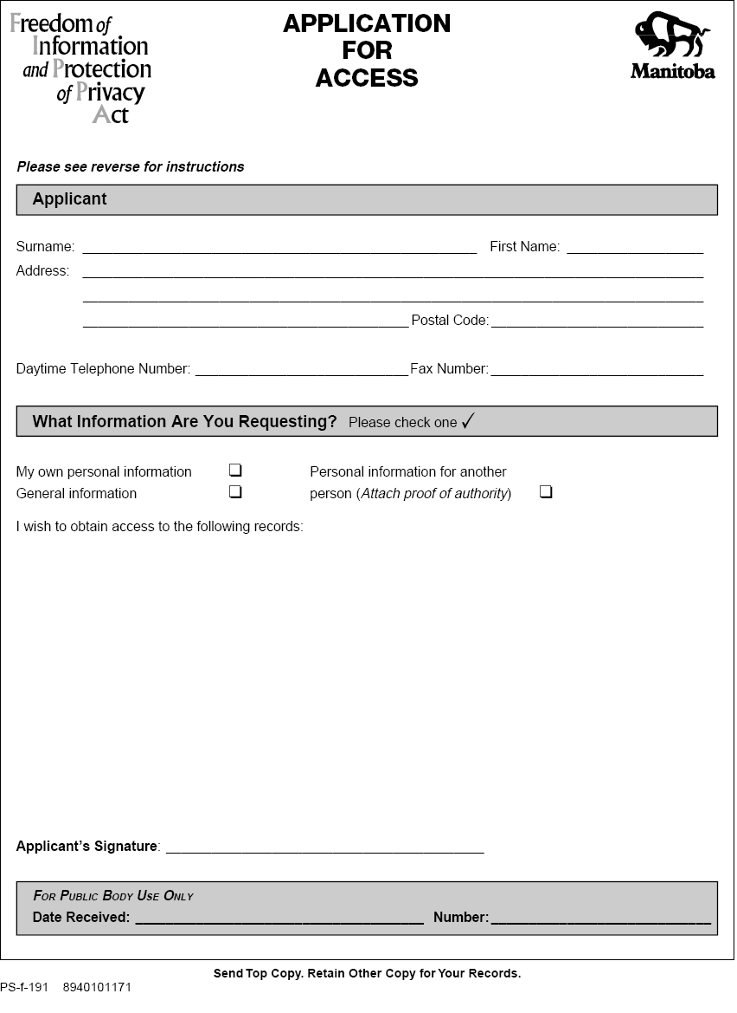
The form...

Slide 3
Top Ten Things to Consider When Applying For Info
Confirm you can’t get it without filing a request
Budget – two hours for free
Confirm correct body to file the request with
Be clear about what you want
Avoid being overly broad
Be sure to state a time frame
Consider privacy issues/flexibility in request
Know what is covered by FIPPA
Submit multiple requests to avoid costs
FOI requests access docs/data, not opinions

Slide 4
Uncovered Through FOIs...
Western Premier’s Conference Expenses - $35,000 in gifts and other political expenses secretly paid for by Manitoba’s crown corporations
Keeyask Dam Expenses - $40 million spent on ‘negotiation and process costs’ for new hydro dam
City Council Expenses - $7,000 secret account details exposed
Spa Day and CFS Bonuses – CFS Employees’ spa day expenses revealed in addition to ‘show up for work’ bonuses
Bracket Creep figures – little known tax aspect which costs Manitobans millions
Western Economic Diversification - federal department’s woeful track record on ‘loan repayments’ and accountability

Slide 5
Sample Wording
MLCC
“Please provide information as to how much the MLCC spent on store renovations between 2004/05 – 2007-08.”
Competitiveness, Training & Trade
“Please provide copies of all receipts and invoices from Talbot Marketing since January 1, 2006.”
City of Winnipeg
“Please provide revenue and expenditure estimates for Assiniboine Park Zoo from 2004/05-2007/08.”

Slide 6
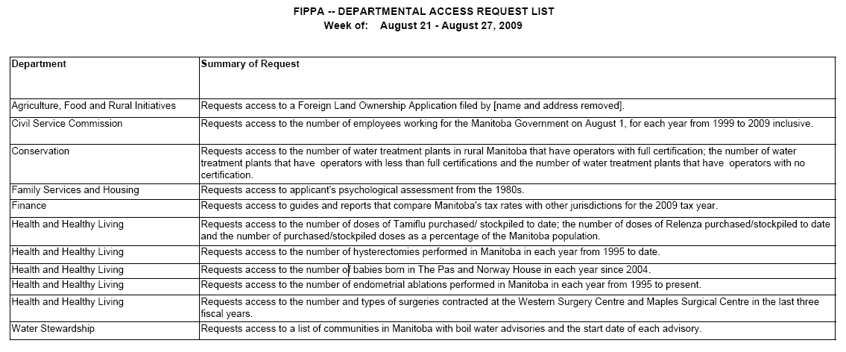
Samples of other information requested...
Summary of weekly information requests filed here - http://www.gov.mb.ca/chc/fippa/routine_disclosure.html

Slide 7
Links/Resources
Orders in council - http://www.gov.mb.ca/minister/orderincouncil/index.html
Federal Access to Information site - http://www.tbs-sct.gc.ca/tbsf-fsct/350-57-eng.asp
Electronic version of FOI form - www.taxpayer.com/bank/pageimages/FOIFORM-generic.doc
City Council expenses - http://winnipeg.ca/council/ExpensesCouncilWard.stm
Mayor’s expenses - http://winnipeg.ca/council/ExpensesMYO.stm
Sewage spills - http://www.gov.mb.ca/waterstewardship/quality/incidents.html
Government tenders - http://www.merx.com/
Provincial cabinet orders - http://www2.gov.mb.ca/oic/OrdersinCouncil.aspx
Health care wait times - http://www.gov.mb.ca/health/waittime/index.html?/index.html
Crime in your neighborhood - http://www.winnipeg.ca/CrimeStat/
West Nile Virus info - http://www.gov.mb.ca/health/wnv/stats.html#mosquito
Emergency room wait times - http://www.gov.mb.ca/health/rha/erstats.html
City council expenses – http://winnipeg.ca/council/ (click on expenses)
Cabinet Ministers’ expenses - http://www.gov.mb.ca/minister/minister_expenses.html
Restaurant Inspection results - http://www.winnipeg.ca/cms/ehs/food/dinersdigest.stm
Provincial Ombudsman - http://www.ombudsman.mb.ca/
Provincial government employees who earn over $50,000 (click on volume 2) http://www.gov.mb.ca/finance/pdf/annualreports/pubacct_2_07.pdf

Slide 8
Presentation available @
www.taxpayer.com/blog
Official Blog of the Canadian Taxpayers Federation

